Slide 1
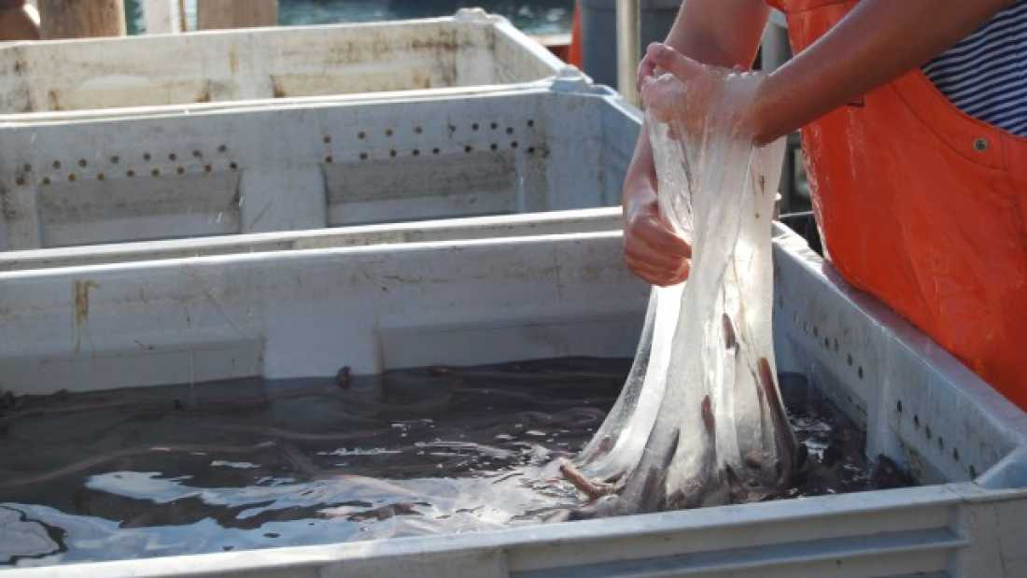
Organic Compounds
What are living things made of?

Slide 2
Phenomenon: What is the hagfish slime made from?

Slide 3
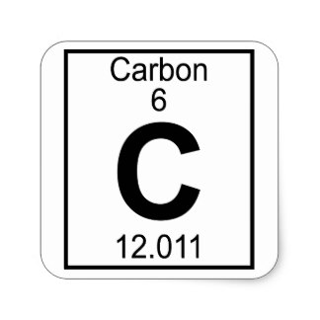
1. Organic compounds are components that make up all living things.
They are build around the element CARBON (C) which can form long chains.
Examine the element carbon as seen on the periodic table. What do each of the symbols mean?

Slide 4
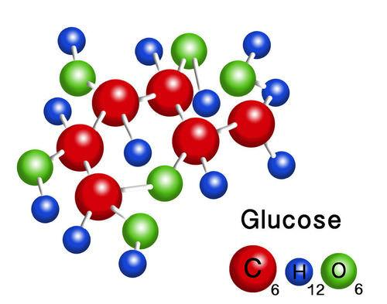
2. Macromolecules are large molecules, or polymers, that are made from smaller units called monomers.
Glucose is a macromolecule made of 6 carbons, 12 hydrogens, and 6 oxygens.
C₆H₁₂O₆

Slide 5
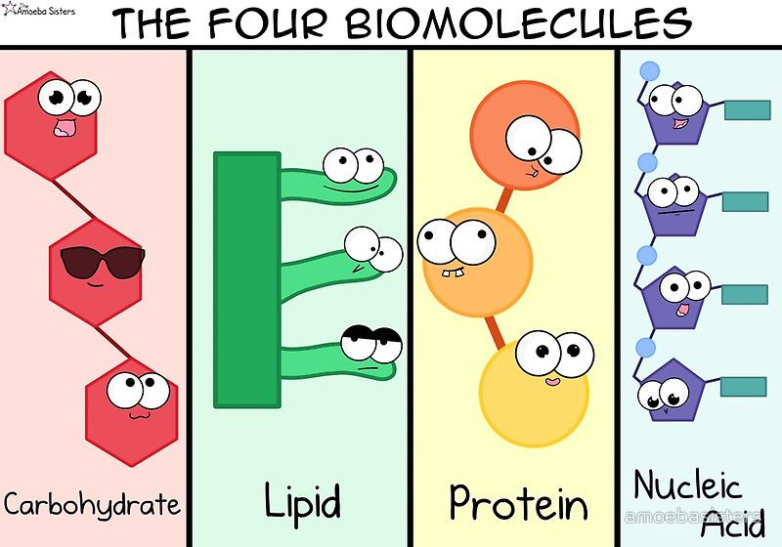
3. Four macromolecules found in living organisms
1. Proteins
2. Carbohydrates
3. Lipids
4. Nucleic Acids

Slide 7
Amoeba Sisters - Biomolecules
1. What foods are are made of carbohydrates? ___________
2. What is the monomer of a carbohydrate? ____________
3. Lipids are made of fatty acids and ________________.
4. What function do lipids (fats) serve for seals?
5. What types of food are high in protein? _______________
6. Proteins are made of what monomer? ________________
7. What is the monomer of nucleic acids? _________________
8. What two molecules are made of nucleic acids?_____________

Slide 8
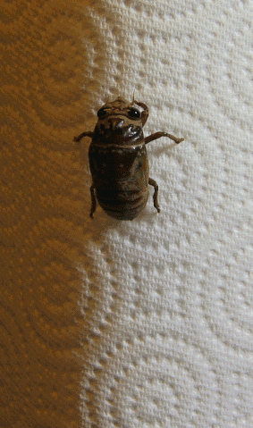
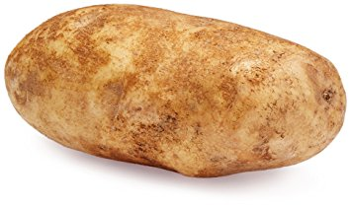
Carbohydrates
Made from chains of glucose
Sugar, glucose, starch
Cellulose found in cell walls of plants
Chitin of insect exoskeletons

Slide 9
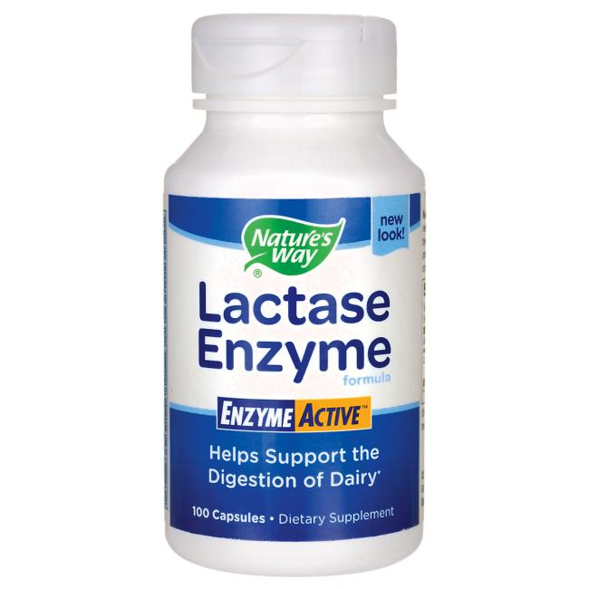
Proteins
Made from amino acids
Compose muscle fibers
Antibodies of the immune system
Enzymes to help speed up reactions
Lactase is an enzyme that helps us break down milk sugar (lactose)

Slide 10
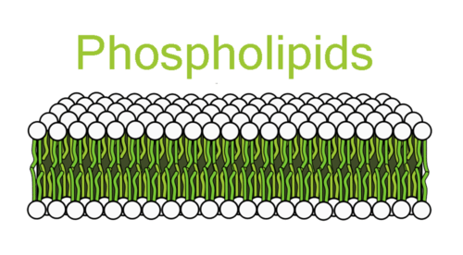
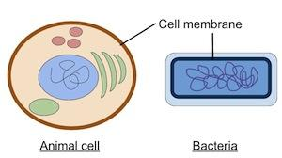
Lipids
Fats, oils, waxes
Can be solid or liquid
Major component of the cell membrane (phospholipid)

Slide 11
Nucleic Acids
Made of individual nucleotides
Component of DNA and RNA
Information storage molecules

Slide 12
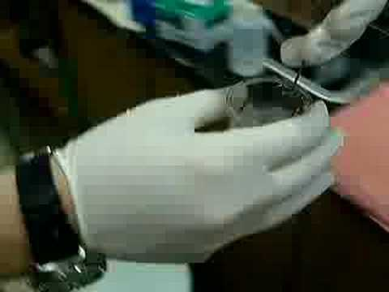
Remember the hagfish slime?
Think - Pair - Share
Discuss with your elbow partner which biomolecule you think the slime is made from and WHY. What purpose does this serve for the fish?
Be prepared to share your reasoning.
Independent Reading: Hagfish Slime by Smithsonian, CER

Slide 13
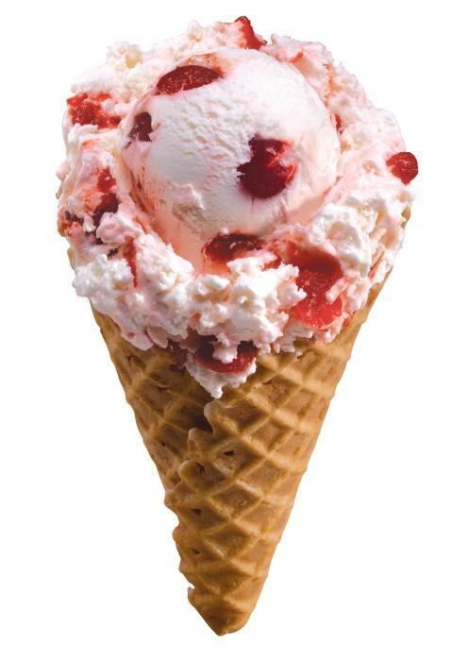
Why Can’t some people eat Ice Cream?
Milk and dairy products are composed of a sugar called lactose. In order to break down that sugar, cells must be able to produce the enzyme: lactase.
Without lactase, the milk sugar is not broken down and can cause symptoms like a stomach aches, gas, and vomiting.
What do you think the treatment is for someone who is “lactose intolerant?”

